Slide 1
Design and Implementation of a Small Scale Stand Alone Hybrid Solar PV Generation
Team Members: Hussein Ghitan, Adam Schroeder, and Anna Schulte
Advisor/Client: Venkataramana Ajjarapu - Professor of Electrical Engineering
Team Website: https://sddec19-06.sd.ece.iastate.edu/ , Team Number: sddec19-06
Notes:
Explain why Ajjarapu is both our Advisor and Client

Slide 2
Project Statement
For students in the EE 452 lab
Understand the characteristics of stand alone solar PV systems
Understand maximum power point tracking (MPPT)
Re-engineer the system to ensure its functionality
Notes:
Adam

Slide 3
Why is this project important?
Solar panels are becoming more popular in the power market today
Significance of our project and PV system
Education
Maximum Power Point Tracking (MPPT)
Notes:
Adam

Slide 4
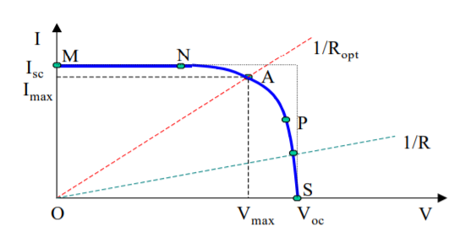
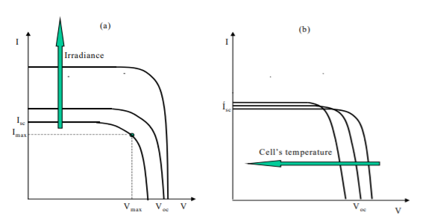
Introduction: Physics of PV System
Notes:
Hussein

Slide 5
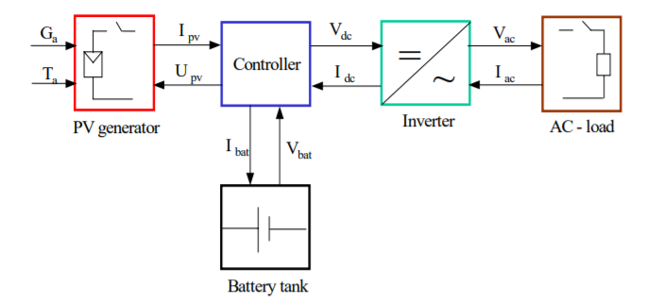
PV System Block Diagram
Notes:
Hussein

Slide 6
Project Plan: Safety
High voltage
Two solar panels each rated 22.1 open circuit voltage
Two 12V batteries
Short circuits
No labeling
Notes:
Anna

Slide 7
Hardware Introduction
Made up of two fundamental circuits
Power circuit
Measurement circuit
Notes:
Anna

Slide 8
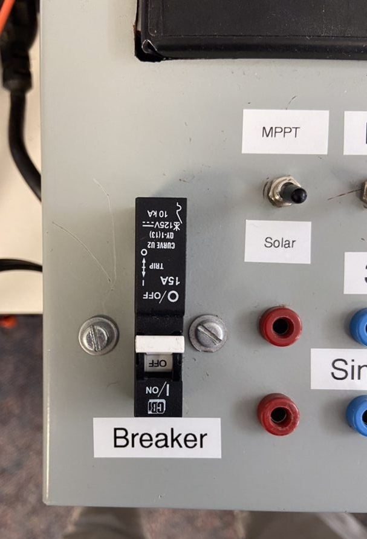
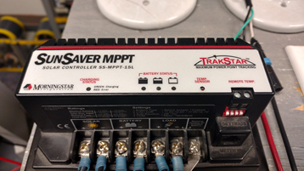
Technical Problems: Breaker and Polarity
Notes:
Anna

Slide 9
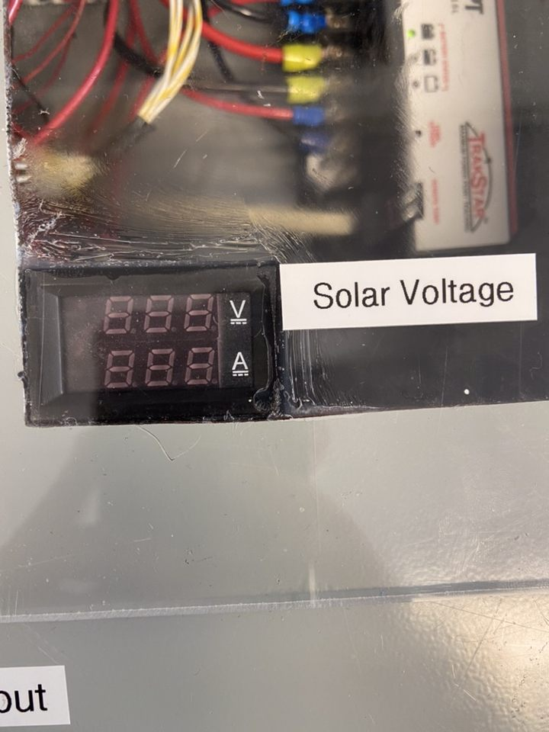
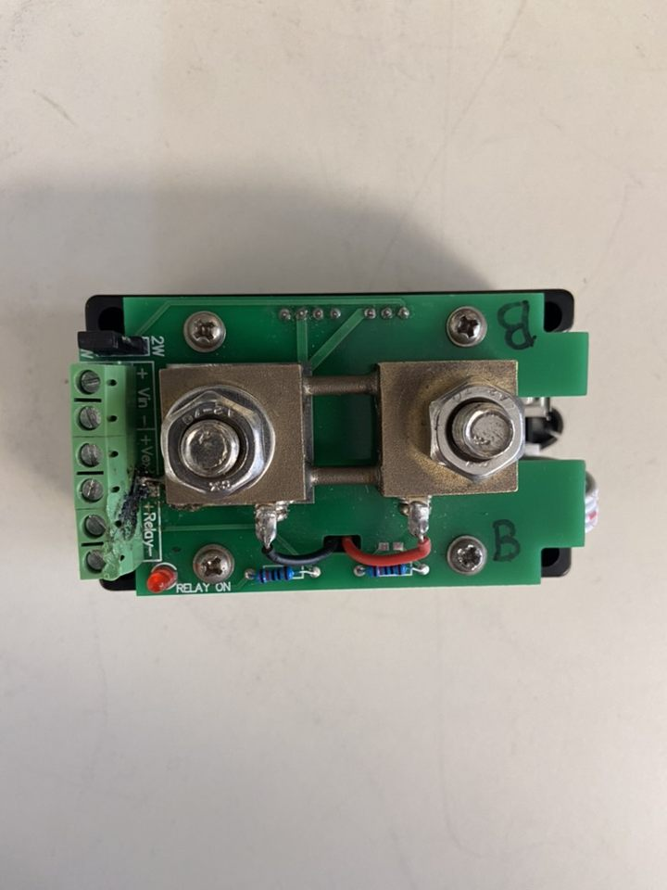
Technical Problems: Multimeters
Notes:
Adam

Slide 10
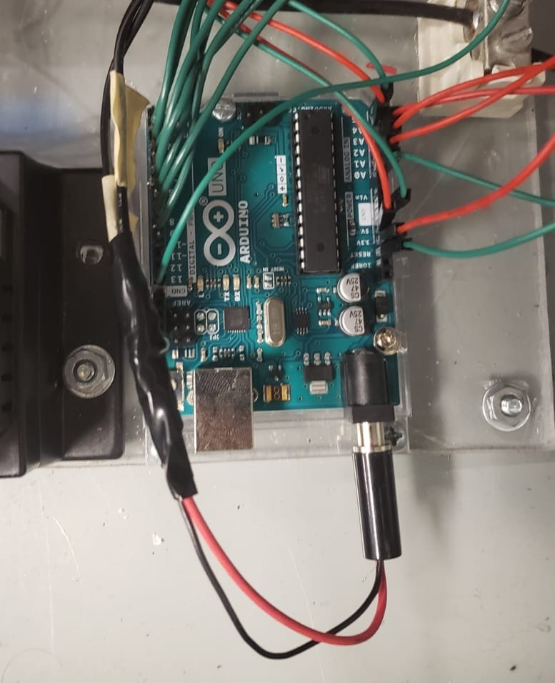
Technical Problems: Arduino
Notes:
Hussein

Slide 11
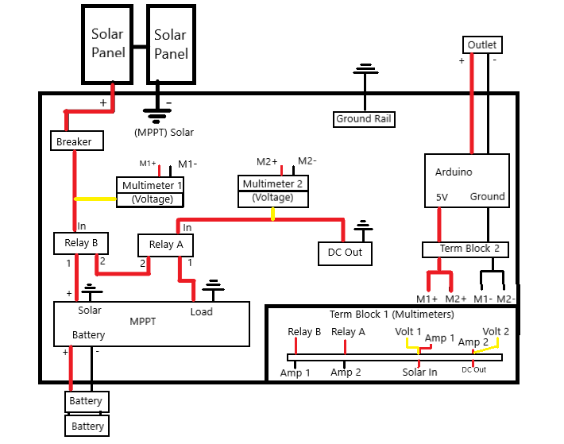
Project Design
Notes:
Adam

Slide 12
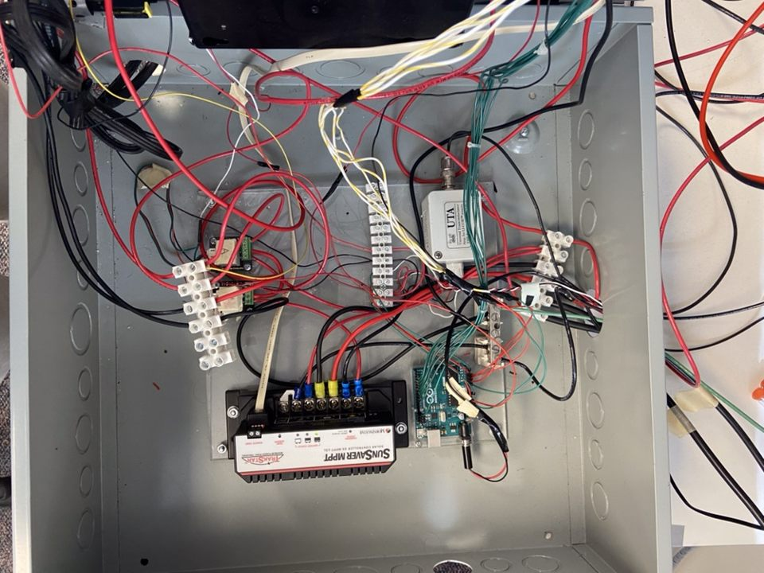
Internal of Hardware
Notes:
Adam

Slide 13
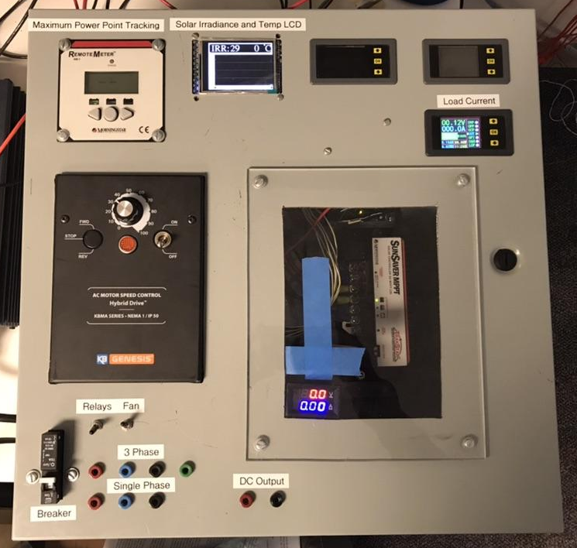
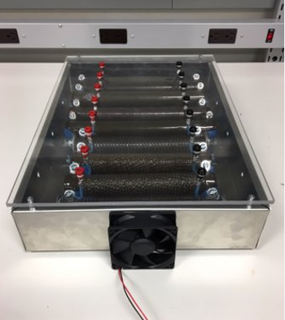
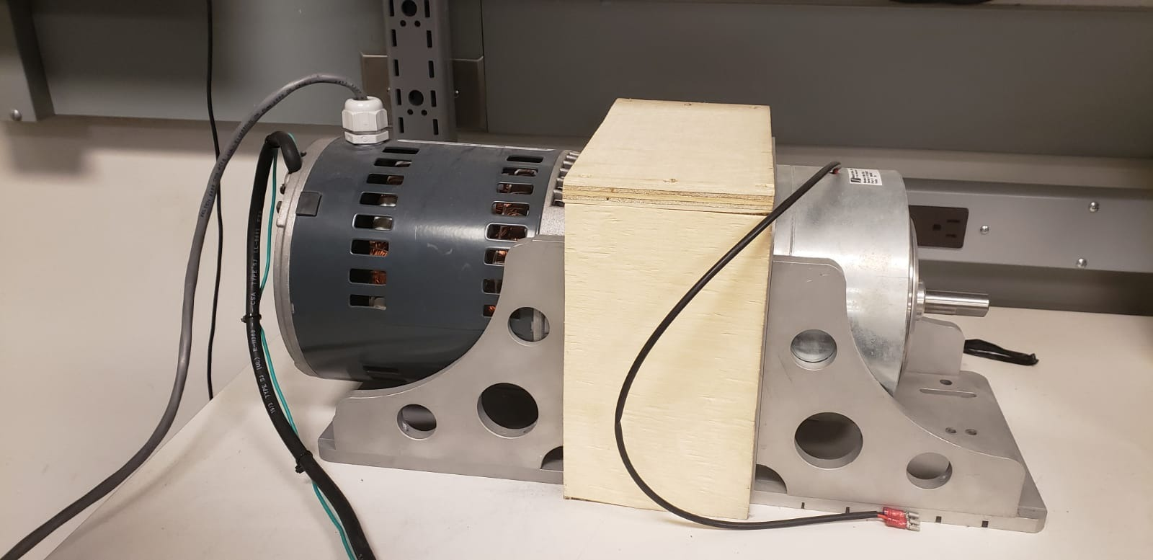
Project Design

Slide 14
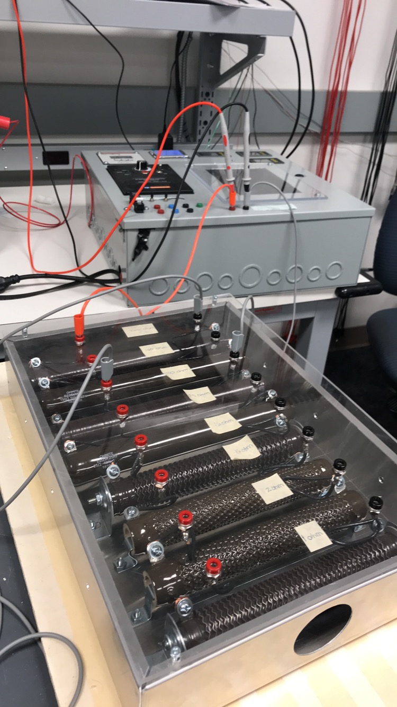
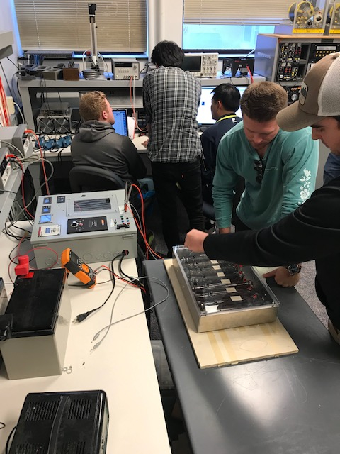
EE452 Lab Work

Slide 15
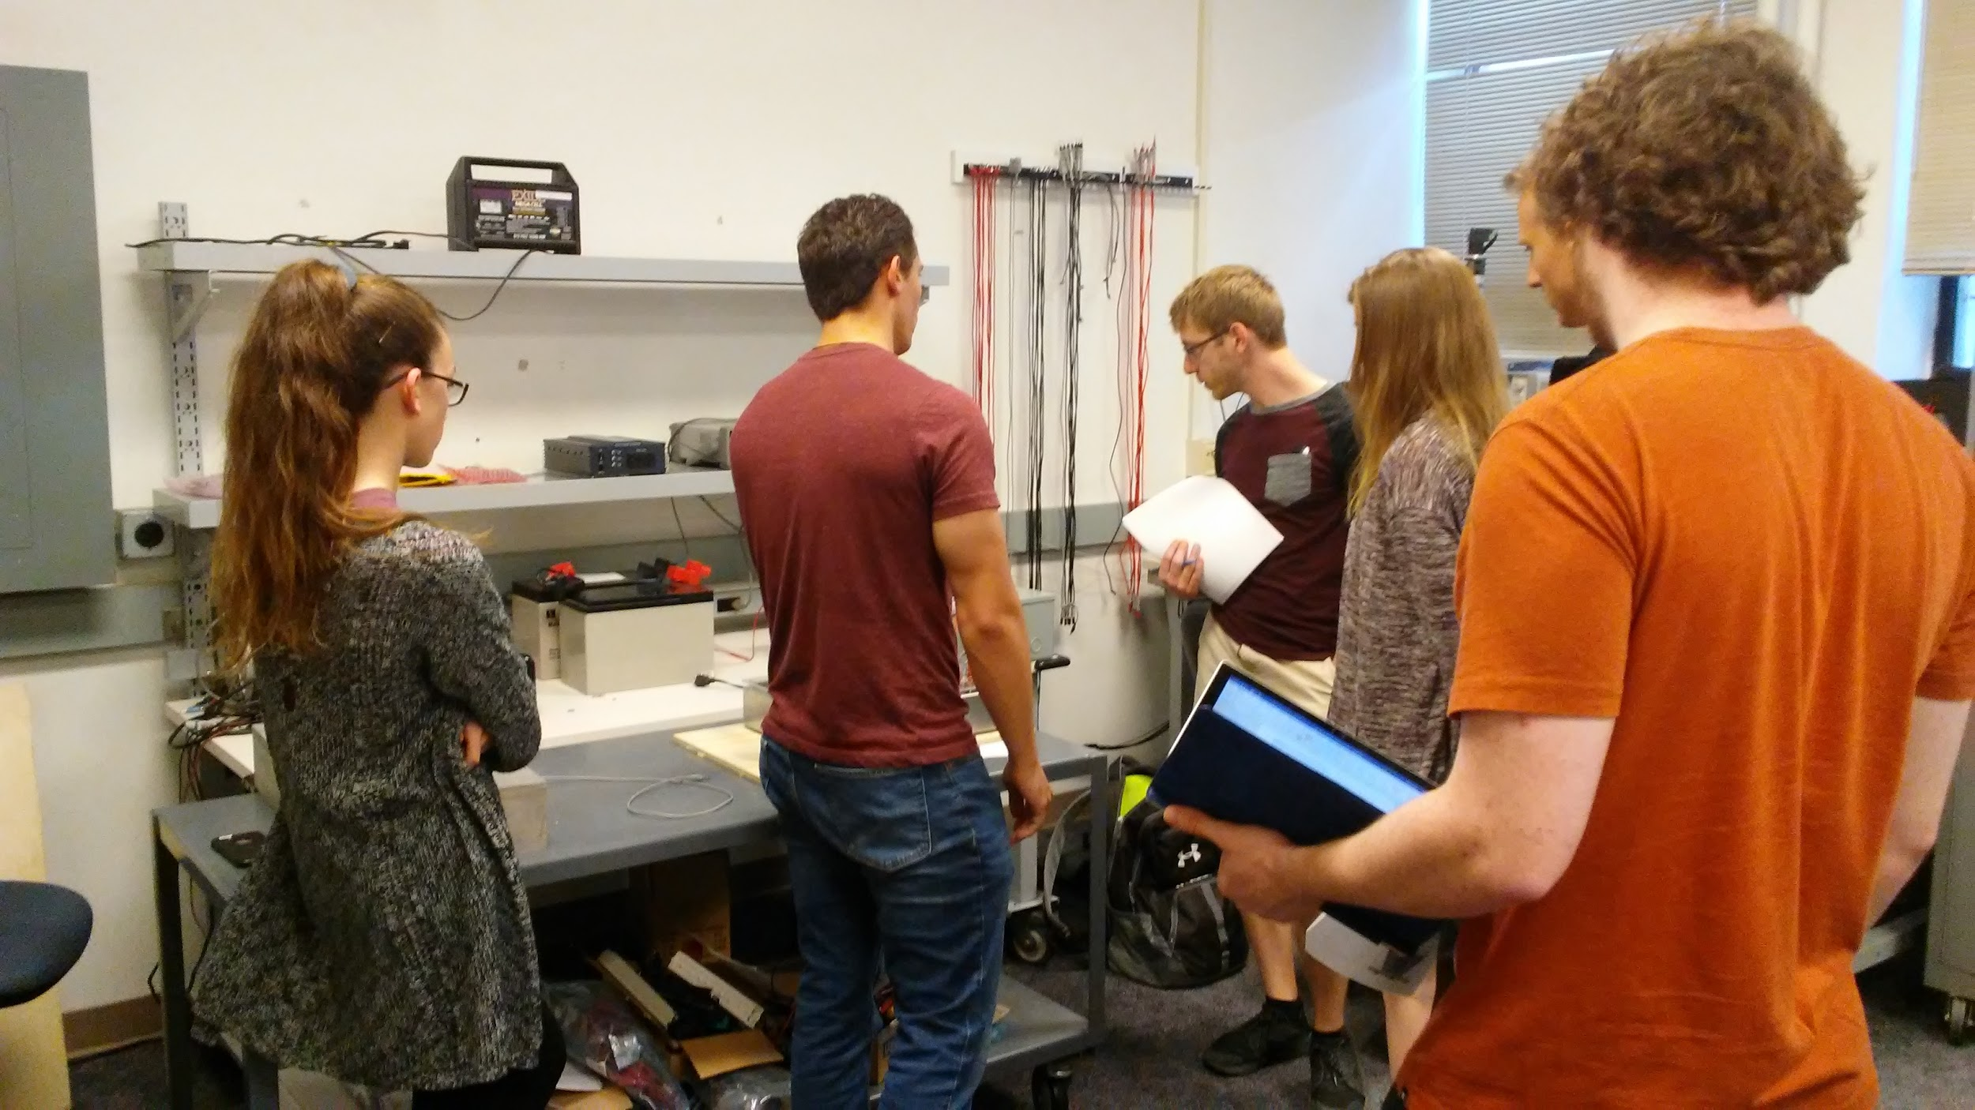
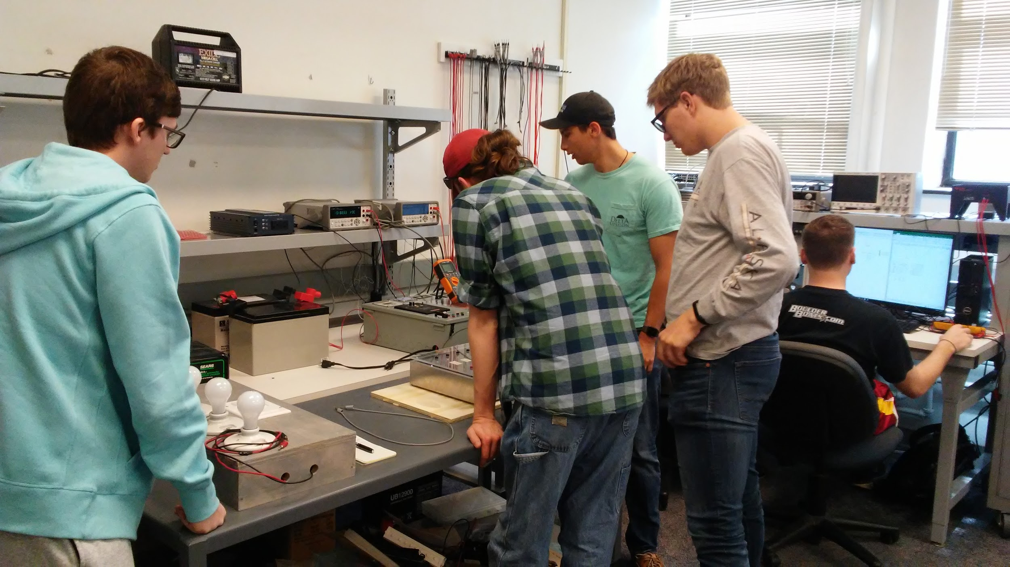
EE452 Lab Work

Slide 16
SOFTWARE: SIMULINK PV SYSTEM MODEL
Notes:
Hussein

Slide 17
Questions?

